Slide 1
EECE 229 Introduction to Digital Systems

Slide 2
Chapter 4
FPGA and Verilog Hardware Description Language

Slide 3
FPGA

Slide 4
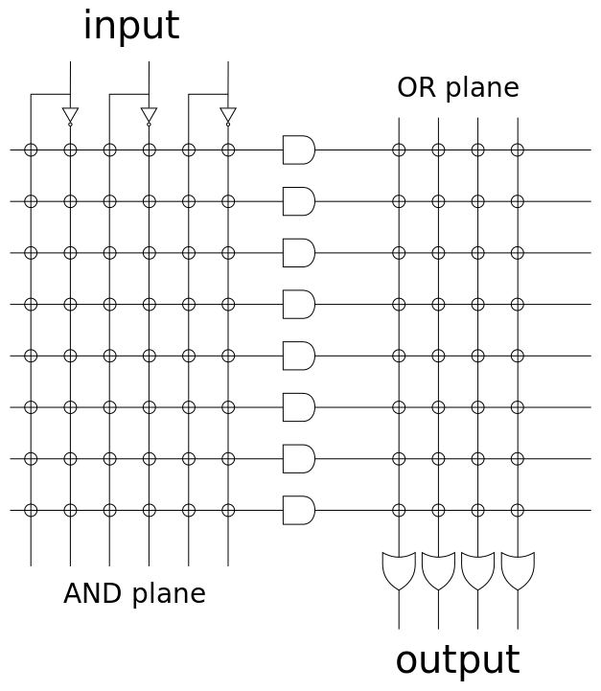
Evolution of implementation technologies
Logic gates (1950s-60s)
Regular structures for two-level logic (1960s-70s)
muxes and decoders, PLAs
Programmable sum-of-products arrays (1970s-80s)
PLDs, complex PLDs
Programmable gate arrays (1980s-90s)
densities high enough to permit entirely new class of application, e.g., prototyping, emulation, acceleration
trend toward higher levels of integration
Notes:
programmable logic device

Slide 5
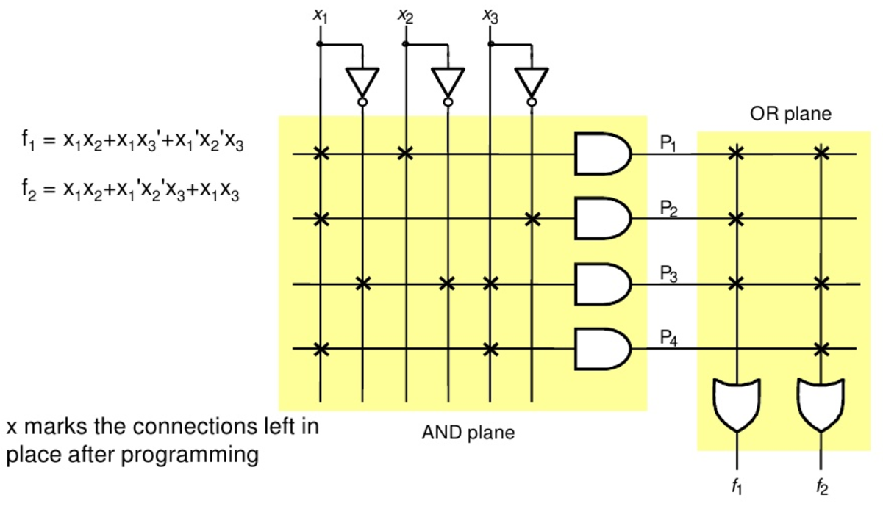
PLAs
Notes:
programmable logic device used to implement combinational logic circuits.

Slide 6
Gate Array Technology (IBM - 1970s)
Simple logic gates
combine transistors to implement combinational and sequential logic
Interconnect
wires to connect inputs and outputs to logic blocks
I/O blocks
special blocks at periphery for external connections
Add wires to make connections
done when chip is fabbed
“mask-programmable”
construct any circuit

Slide 7
Field-Programmable Gate Arrays
Logic blocks
to implement combinational and sequential logic
Interconnect
wires to connect inputs and outputs to logic blocks
I/O blocks
special logic blocks at periphery of device for external connections
An integrated circuit designed to be configured by a customer or a designer after manufacturing – hence "field-programmable".
Notes:
A field-programmable gate array (FPGA) is an integrated circuit designed to be configured by a customer or a designer after manufacturing – hence "field-programmable".

Slide 8

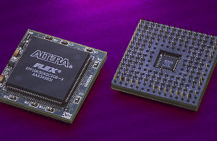
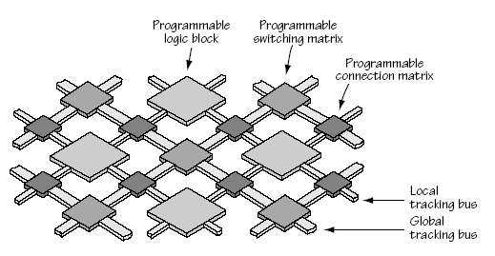
FPGA
Field Programmable Gate Array
New Architecture
‘Simple’ Programmable Logic Blocks
Massive Fabric of Programmable Interconnects
Large Number of Logic Block ‘Islands’
1,000 … 100,000+
in a ‘Sea’ of Interconnects

Slide 9
Verilog Hardware Description Language

Slide 10
Overview
Structural and behavioral modules
Assignment statements
Binary and logical operators
Number representations in Verilog
Data Types: Wire & Reg
Branching statements
Looping
Hierarchal design

Slide 11
Verilog Hardware Description
Verilog resembles the C programming language
Systems are implemented using hierarchical blocks of functionality called modules
A module is a text file that contains declarations and statements
Each module corresponds to a single piece of hardware

Slide 12
Modules
A module starts with the module keyword followed by the name of the module
The module declares one or more input and output ports (signals) enclosed in parenthesis
Statements can describe the module’s operation either structurally, or behaviorally
A Verilog file may contain multiple modules, but it is best if each module is in its own file that is named the same as the module name

Slide 13
Module Declarations
There are two styles of module declaration
One lists the signal names along with their direction and types in the module body
module testing(x1, x2, s, f);
input x1, x2, s;
output f;
endmodule
The other puts the signal direction and type in front of the signal name in the module ports list
module testing(input x1, x2, s, output f);
endmodule

Slide 14
Verilog Nets
A net represents a node in a circuit
Nets can be of different types, but the most important one for synthesis is of type wire
A wire connects an output of one logic element to the input of another
The default type for a signal name without a declared type is wire

Slide 15
Verilog Variables
Variables allow a circuit to be described in terms of its behavior
A variable can be assigned a value in one statement and it retains its value until overwritten by another statement
There are two types of variables:
reg
integer
All signals that are assigned a value using procedural statements must be variables

Slide 16

Signal Vectors
Rather than declaring a net or variable for each signal, such as x0, x1, x2, x3, vectors of signals can be used instead: type[msb:lsb]
wire[3:0] x; or reg[3:0] x;
Individual bits can be specified by index: x[1]
All of the bits can be specified by vector name: x

Slide 17
Verilog Abstract Levels

Slide 18
Verilog Abstraction Levels
Verilog supports designing at many different levels of abstraction. Three of them are very important:
Behavioral level
Register-Transfer Level
Gate Level

Slide 19
Gate Level: Structural Modules
Structural modules use Verilog gate primitives (and, or, not) to describe the structure of a circuit
Primitive instance parameters
Output is first signal, followed by the inputs
Example: and(z, w, x, y); describes a three input and gate with inputs w, x, y, and the output z
Notes:
All signals are discrete signals. They can only have definite logical values (`0', `1', `X', `Z`)

Slide 20
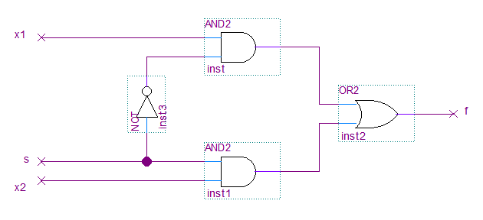
Gate Level: Structural Modules

Slide 21
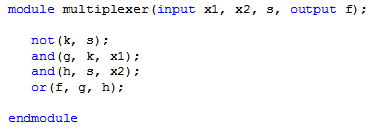
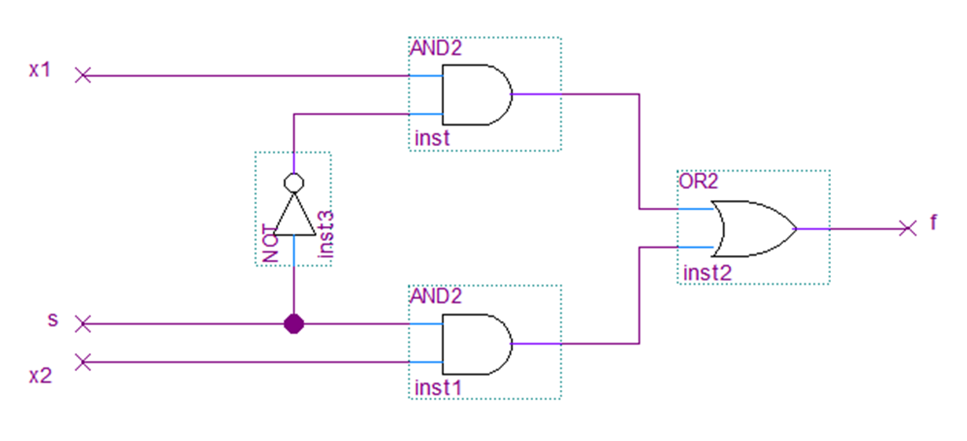
Gate Level: Structural Modules

Slide 22
Register Transfer Level
A design abstraction which models a synchronous digital circuit in terms of the flow of digital signals (data) between hardware registers, and the logical operations performed on those signals.
Specify the characteristics of a circuit by operations and the transfer of data between the registers.
Continuous assignment (assign) to a signal
Assignment must be of a net type (wire)
Use logic operators to assign a value to a signal
And: &
OR: |
Not: ~
Xor: ^
Notes:
a design abstraction which models a synchronous digital circuit in terms of the flow of digital signals (data) between hardware registers, and the logical operations performed on those signals.

Slide 23

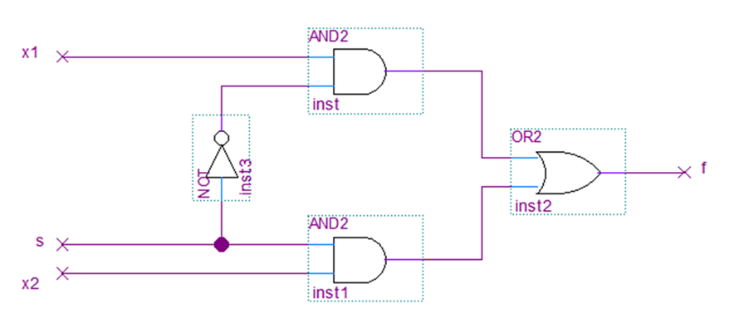
Register Transfer Level

Slide 24
Behavioral Level
Using gate-level primitives or logic expressions is difficult with large circuits
The alternative is to use abstractions and programming constructs to describe the desired input to output relationships
it consists of a set of instructions that are executed one after the other.
Functions, Tasks and Always blocks are the main elements.
There is no regard to the structural realization of the design.

Slide 25
Behavioral Modules – Cont’d
The always Verilog keyword identifies the signals that will trigger the execution of the procedural statements
Consecutive statements following the always must be within a begin and end section

Slide 26
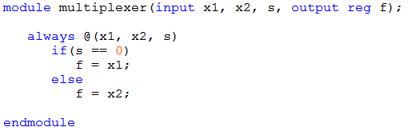
Behavioral Modules

Slide 27
Verilog Adder
module adder(input wire[7:0] a, b,
output wire[7:0] sum);
assign sum = a + b;
endmodule
Continuous assignment for signal sum

Slide 28
Subtractors
Same X and Y inputs as an adder
Borrow in and borrow out
D output is the difference between X and Y
B-A = B+A’+1

Slide 29
Verilog Subtractor
module subtractor(input wire[7:0] a, b, output wire[7:0] diff);
assign diff = a - b;
endmodule

Slide 30
Verilog Multiplexer
module mux4(input wire[7:0] a, b, c, d,
input wire[1:0] select, output reg[7:0] z);
always @(select, a, b, c, d)
begin
case(select)
2'b00 : z = a;
2'b01 : z = b;
2'b10 : z = c;
2'b11 : z = d;
endcase
end
endmodule
Notes:
In order to assign a value to an output in an always process block, the output must be of a variable type; reg in this example.

Slide 31
Comparators
A circuit that compares two binary words and indicates if they are equal
Signed or unsigned versions
Greater or less than outputs
Magnitude comparators

Slide 32
Verilog Comparator
module comparator(input wire[7:0] A, B,
output wire ALTB, AGTB, AEQB);
assign ALTB = A < B;
assign AGTB = A > B;
assign AEQB = A == B;
endmodule
Notes:
There is an optimization available to us in the above circuit: AEQB = !(ALTB || AGTB)
It could possibly save the synthesis of one comparator circuit.

Slide 33
Data Types

Slide 34
Wire
A wire represents a physical wire in a circuit and is used to connect gates or modules. The value of a wire can be read, but not assigned to, in a function or block.
A wire does not store its value but must be driven by a continuous assignment statement or by connecting it to the output of a gate or module.
wire elements are the only legal type on the left-hand side of an assign statement.
wire elements are a stateless way of connecting two pieces in a Verilog-based design.
wire elements can only be used to model combinational logic.
wire c // simple
wire [9:0] A; // a cable (vector) of 10 wires

Slide 35
Reg
Declare type reg for all data objects on the left hand side of expressions in initial and always procedures, or functions.
reg elements can be used as outputs within an actual module declaration.
reg elements cannot be used as inputs within an actual module declaration.
reg cannot be used on the left-hand side of an assign statement.
reg can, therefore, be used to create both combinational and sequential logic.
reg a; // single 1-bit register variable
reg [7:0] tom; // an 8-bit vector; a bank of 8 registers.
reg [5:0] b, c; // two 6-bit variables

Slide 36
Continuous assignment
can only drive wire or tri data type. Which means left-side data type should be net data type.
Continuous assignments should appear outside procedures(always, initial, functions, tasks, etc)
It executes each time the right hand side expression changes. It overrides any procedural assignment.
A wire should be assigned only once using continuous assignment.
Only combinational logic can be modeled using Continuous Assignment.
Notes:
Net data types are used to model physical connections. They do not store values.
The wire and tri nets connect elements. The net types wire and tri are identical in their syntax and functions; two names are provided so that the name of a net can indicate the purpose of the net in that model.
A wire net is typically used for nets that are driven by a single gate or continuous assignment.
The tri net type might be used where multiple drivers drive a net.

Slide 37
Procedural Assignment
can drive only reg, integer, real and time data type.
left-side data type cannot be nets.
Procedural Assignment should appear inside procedures.
It can model both combinational and sequential logic.

Slide 38
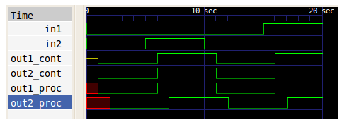
Example
module cont_proc(in1, in2, out1_cont, out2_cont, out1_proc, out2_proc);
input in1, in2;
output out1_cont, out2_cont, out1_proc, out2_proc;
wire in1, in2 ,out1_cont, out2_cont;
reg out1_proc, out2_proc;
//continuous assignment
assign #2 out1_cont = in1 | in2;
assign #1 out2_cont = in1 | in2;
always@(in1, in2) begin
//procedural assignment
#2 out1_proc = in1 | in2;
#1 out2_proc = in1 | in2;
end
endmodule
Notes:
out1_cont and out2_cont are assigned using continuous assignment and hence each occurs irrespective of the other statement. While out1_proc and out2_proc are procedurally assigned and hence out2_proc is assigned only after assignment to out1_proc is finished.

Slide 39
Assignment statements

Slide 40
Always(Sensitivity List)
always @(s1, s2, f)
sensitive to changes in s1 or s2 or f
always @(*)← same as → always @*
sensitive to anything that affects the output
always @(posedge clk)
sensitive to 0→1 transitions on signal clk
The output signal must maintain its value between executions, so the signal has to be declared as a variable type (reg or integer)
All always processes defined in a module will execute together at the same time

Slide 41
Binary and logical operators
Bitwise operators:
and: &, or: |, not: ~, xor: ^
f = a & ~b
Logical and comparison operators:
Used in conditional tests
and: &&, or: ||, not: !, equal: ==,
not equal: !=, less than: <, greater than: >
if ((a == b) || (a > b) && (c < d) || (e != f))
Notes:
All of the operators are described in section 4.6 of Brown.
There is a complete chart on page 224 of Brown showing all of the Verilog operators

Slide 42
Number representations in Verilog

Slide 43
Numbers in Verilog Code
Numbers in Verilog can be specified in binary (b), octal (o), decimal (d), or hexadecimal (h)
For sized numbers, the format is:
<size_in_bits>’<radix><digits>
12’b1001_0001_1100
12’o4464
12’h91c
12’d2332
By default, integer values are signed 32-bit numbers

Slide 44
Branching Statements & Looping

Slide 45
Conditional Operator
conditional_test ? true_result : false_result;
assign f = (x==0) ? 1 : 0;
// Mux 2:1
module mux2to1(w0, w1, s, f);
input w0, w1, s;
output f;
assign f = s ? W1 : w0;
endmodule

Slide 46
If statement
Branching based upon conditional tests
Multiple statements in a particular condition can be grouped with begin -> end statements
Implies priority
First true evaluation takes priority and others are not evaluated
if (conditional_test)
true_statement;
else if(another_conditional_test)
true_statement;
else
false_statement;

Slide 47
Looping
Helps to create larger circuits based upon a small pattern
Subtle differences from software
Careful of variable ending values
for (begin_index; end_index; increment)
statement;

Slide 48
Parameters
Similar to generics
Allows engineer to design general circuits once that then scale to specific needs

Slide 49
Bit Counter
Produce a count of the number of bits in the n-bit input X that have the value 1.
module bit_counter(X, Count);
parameter n=4;
parameter logn=2;
input [n-1:0] X;
output reg[logn:0] Count;
integer k;
always @ (X)
begin
Count =0;
for (k=0; k<n; k=k+1)
Count = Count + X[k];
end
end module

Slide 50
Hierarchical Design

Slide 51
Hierarchical Design
Used to manage large projects
Hides complexity when you don’t want to see it
module A(input x,y,z, output s0,s1);
assign s0 = x | y | z;
assign s1 = x&y&z;
endmodule
module B(input x,y, output s0);
assign s0 = x^y;
endmodule
module C(input x,y,z,output s0,s1);
wire s3;
B(x,y,s3);
A(s3,y,z,s0,s1);
endmodule

Slide 52
Full Adder Example
module addern(carryin, X, Y, S, carryout, overflow); (Chapter 3.56-3.57)
parameter n = 32;
input carryin;
input [n-1:0] X,Y;
output reg [n-1:0] S;
output reg carryout, overflow;
always @(X,Y,carryin)
begin
{carryout, S} = X + Y + carryin;
overflow = (X[n-1]&Y[n-1]&~S[n-1]) |
(~X[n-1]&~Y[n-1]&S[n-1]);
end
endmodule

Slide 53
Alternative Solution
Assume A is the output.
assign A = ((~cin) & x &(~y)) | ((~cin) &(~x)&y ) | (cin &(~x) &(~y)) | (cin & x & y) ;
assign cout = ((~cin) & x &y) | ((cin) &(~x)&y ) | (cin &(x) &(~y)) | (cin & x & y) ;

Slide 54
Hierarchical Design Usage
Module adder_hier(A,B,C,D,S,T,overflow);
input [15:0] A,B;
input [7:0] C,D;
output [16:0] S;
output [8:0] T;
output overflow;
wire o1,o2;
addern U1(1’b0,A,B,S[15:0],S[16],o1);
defparam U1.n = 16;
addern #(8) U2(1’b0,C,D,T[7:0],T[8],o2);
defparam U2.n = 8;
assign overflow = o1 | o2;
endmodule
A circuit consisting of two adders as follows:
One adder generates a 16-bit
sum S= A+B
Another adder generates a 8-bit sum T=C+D
defparam sets the n to 16

Slide 55
Hierarchical Design
Alternative
addern #(.n(16)) U1
(
.carryin(1’b0),
.X(A),
.Y(B),
.S(S[15:0]),
.carryout(S[16]),
.overflow(01)
);

